Slide 1

Data analysis with Python Deep Dive & Implementation Workshop
Dr. Jorge Davila-Chacon Olaf Erichsen
HSBA - DTB Data Business

Slide 2
Agenda for this week
Monday | Tuesday | Wednesday | Thursday | Friday | Saturday
Python Deep Dive | Python Deep Dive | Linear Regression (House Data + Insurance Data) | Multiple Regression (House Data + Insurance Data) | Preparation: Use your own dataset on regression task | Presentation: Use your own dataset on regression task

Slide 3
Python Deep Dive
 | Monday | Tuesday
09:00 – 10:30 | => Introduction of course plan => Get to know participants + skills => Set-up of computers with Python | Python for Data Analysis – Numpy 1
10:30 – 12:00 | Python for Data Analysis – Basics 1 | Python for Data Analysis – Numpy 2
 | Lunch break | Lunch break
13:00 – 14:30 | Python for Data Analysis – Basics 2 | Python for Data Analysis – Panda 1
14:30 – 16:00 | Python for Data Analysis – Basics 3 | Python for Data Analysis – Panda 2

Slide 4
Simple Linear Regression

Slide 5
Simple Linear Regression
Predict the price of this house

Slide 6
Simple Linear Regression
Predict the price of this house
Variables???

Slide 7
Simple Linear Regression
Predict the price of this house
Variables:
price in $
# bedrooms
# bathrooms
sqft_living
sqft_lot
# floors
...

Slide 8
Simple Linear Regression
Predict the price of this house
Variables:
price in $
# bedrooms
# bathrooms
sqft_living
sqft_lot
# floors
waterfront (yes/no)

Slide 9
Simple Linear Regression
Predict the price of this house
Variables:
price in $
# bedrooms
# bathrooms
sqft_living
sqft_lot
# floors

Slide 10
Simple Linear Regression
Data
Input
Output
x₁ = sqft, y₁ = $
x₂ = sqft, y₂ = $
x₃ = sqft, y₃ = $
x₄ = sqft, y₄ = $
...

Slide 11
Simple Linear Regression
Data
Input
Output
x₁ = sqft, y₁ = $
Input vs. Output
y is the quantity of interest
y can be predicted from x
x₂ = sqft, y₂ = $
x₃ = sqft, y₃ = $
x₄ = sqft, y₄ = $
...

Slide 12
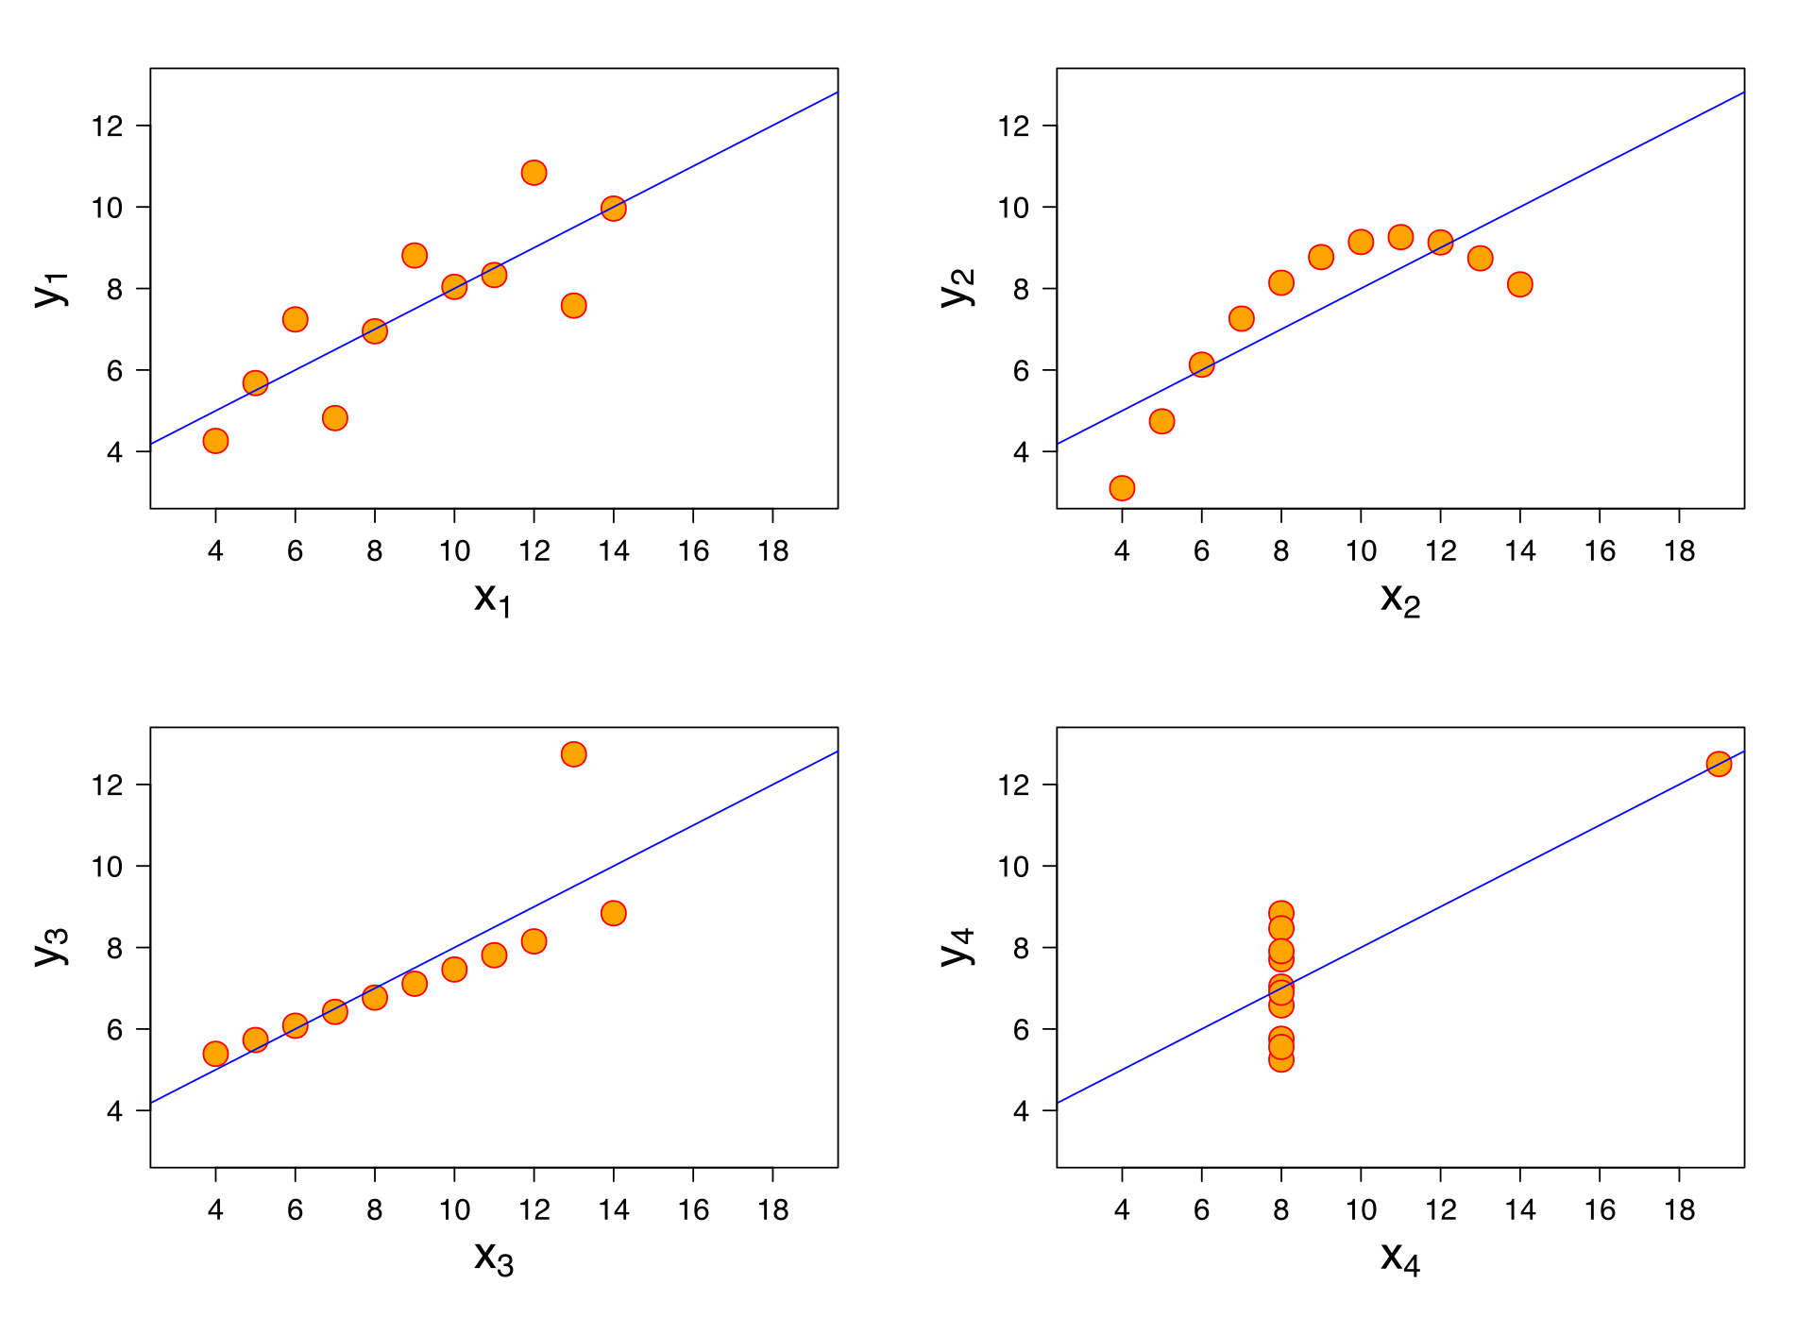
Simple Linear Regression
https://en.wikipedia.org/wiki/Linear_regression

Slide 13
Simple Linear Regression
https://en.wikipedia.org/wiki/Linear_regression
Fit the line to the data
that minimizes the error
(different ways!)

Slide 14
Simple Linear Regression
https://en.wikipedia.org/wiki/Linear_regression
Function
y_{i} = w₀ + w₁x_{i} + Ɛ_{i}
w_{o} = intercept
w₁ = regression coefficient (slope)

Slide 15
Simple Linear Regression
https://en.wikipedia.org/wiki/Linear_regression
Function
y_{i} = w₀ + w₁x_{i} + Ɛ_{i}
w_{o} = intercept
w₁ = regression coefficient (slope)
Examples
7 = 4,2 + w₁*8 + 0 => w₁ = 0,35
11 = 4,2 + 12*0,35 + Ɛ₉ => Ɛ₉ = 2,4

Slide 16
Multiple Regression

Slide 17
Multiple Regression
https://en.wikipedia.org/wiki/Linear_regression
Function
y_{i} = w₀ + w₁x_{i} + w₂x_{i} + Ɛ_{i}
w_{o} = intercept
w₁ = reg_coeff for sqft input variable
w₂ = reg_coeff for # bathrooms
x₂

